Slide 1
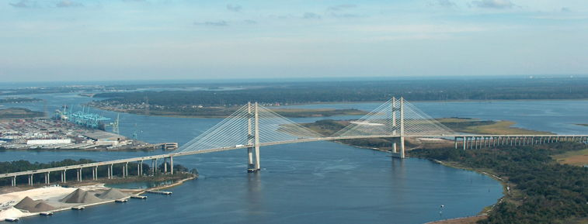
State of the River Report
for the Lower St. Johns River Basin
Water Quality, Fisheries, Aquatic Life, Contaminants
2017
Lower Basin of the St. Johns River Jacksonville, FL
Radha Pyati, Ph.D.
Gerry Pinto, Ph.D.
Notes:
Updated GFP

Slide 2




About the Report
Funded by COJ EPB
Purpose
  Inform the public about the LSJRB health
  Provide independent assessments of status and trends
  First annual report in 2008
Authors
  Dr. Radha Pyati, UNF
  Dr. Brian Zoellner, UNF
  Dr. An-Phong Le, FSC
  Dr. Peter Bacopoulos
  Dr. Gerry Pinto, JU
  Dr. Nisse Goldberg, JU
  Dr. Andy Ouellette, JU
  Dr. Gretchen Bielmyer-Fraser, JU
  Brochure Design: David Smith
Notes:
Updated GFP
Do we need AU logo for David?

Slide 3
About the Report
Reviewers and Advisors:
  SJRWMD
  City of Jacksonville
  FL Dept. of Health
  FDEP
  JEA
  St. Johns Riverkeeper
  Middlebrook Company
  The Nature Conservancy
  FWRI
  FL Sea Grant
  National Park Service
  Wildwood Consulting
  UNF
  JU
  Valdosta State
Special thanks to:
  Dr. Stuart Chalk
  Dr. Lucy Sonnenberg
  Dr. Dan McCarthy
  Ms. Heather McCarthy
  Dr. Pat Welsh
  Ms. April Moore
  Dr. Ray Bowman
  Dr. Quinton White
The River Report is an independent assessment. Reviewing this Report does not imply agreement with opinions and conclusions reached by the Report’s authors.
Notes:
Updated GFP
RP – I’ve modified the text of the independent assessment note by using the exact language used in the Preface.

Slide 4
About the Report
Interactive website – searchable by COJ council district and planning district
Topics
  Ten-Year Summary Section
  Highlight – Bottlenose dolphins, by Dr. Rose Borkowski, JU
  Background
  Water Quality
  Fisheries
  Aquatic Life
  Contaminants
Full Report
Appendices
Digital archive of references
Brochure
SJRreport.com
Notes:
Updated GFP

Slide 5
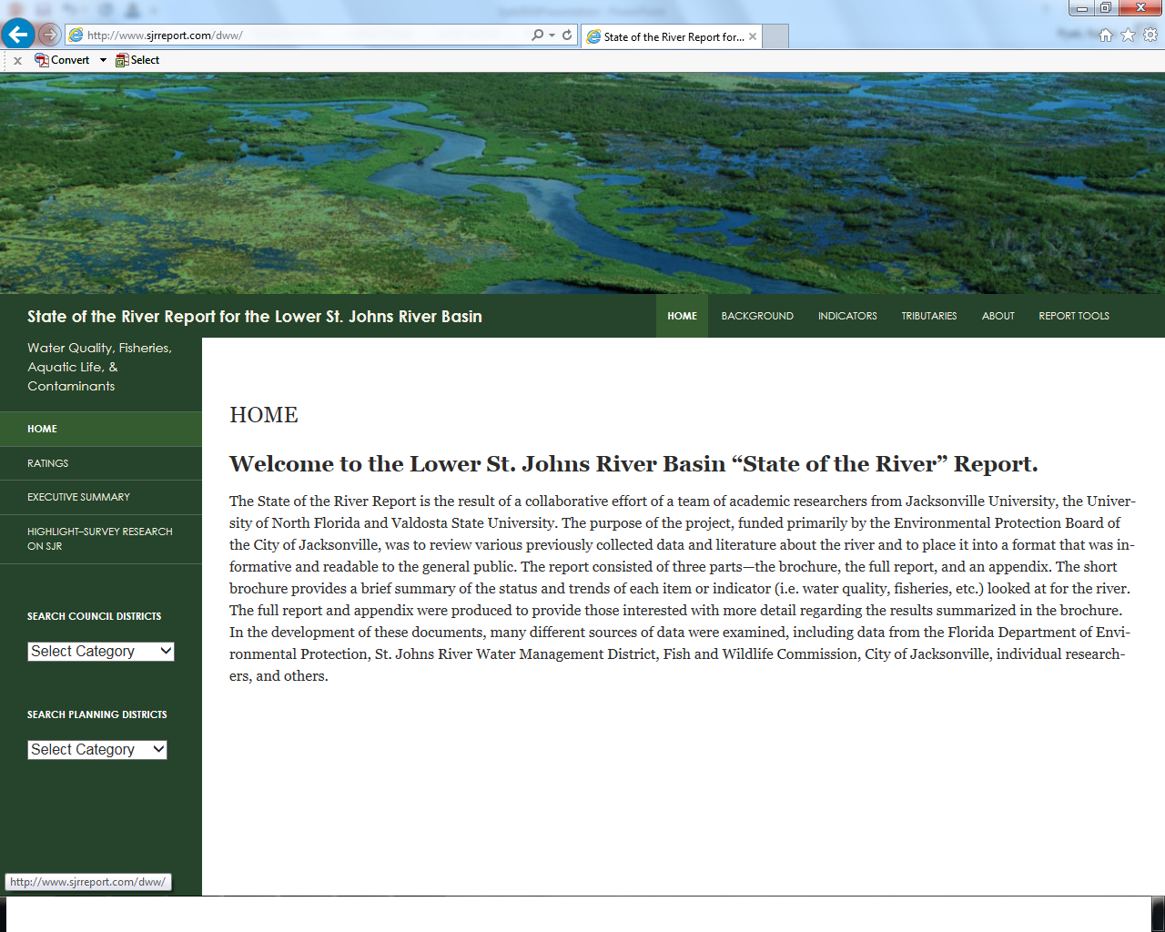
Website
Notes:
Kept Updated GFP

Slide 6
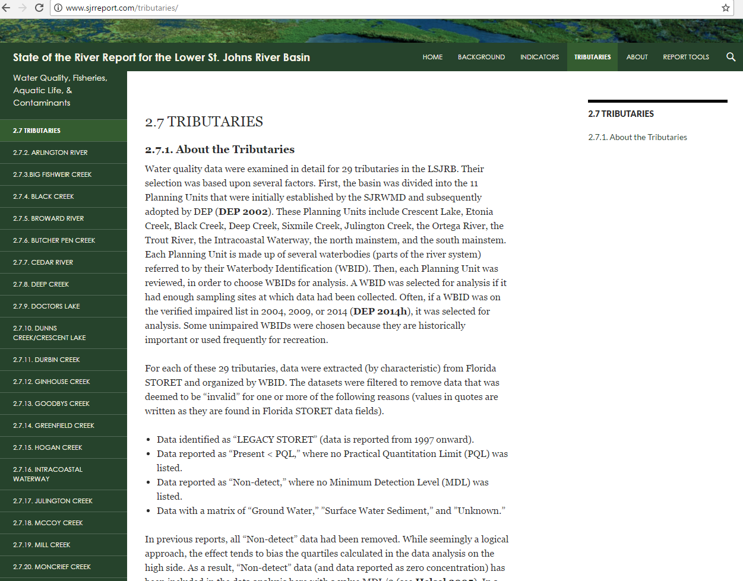
Tributaries
Notes:
Added Updated GFP

Slide 7
Water Quality
Indicator | Status | Trends
Salinity | Unsatisfactory Impacts increasing | Worsening
Fecal Coliform | Mainstem: Uncertain Tributaries: Unsatisfactory | Mainstem: Uncertain Tributaries: Unchanged
Turbidity | Satisfactory | Unchanged
Dissolved Oxygen | Mainstem: Marine/Estuarine Satisfactory Mainstem: Freshwater Satisfactory Tributaries: Unsatisfactory | Mainstem: Marine/Estuarine Unchanged Mainstem: Freshwater Improving Tributaries: Worsening
Algal Blooms | Unsatisfactory | Unchanged
Nitrogen | Mainstem: Unsatisfactory Tributaries: Unsatisfactory | Mainstem: Improving Tributaries: Improving
Phosphorus | Mainstem: Marine/Estuarine Satisfactory Mainstem: Freshwater Satisfactory Tributaries: Unsatisfactory | Mainstem: Marine/Estuarine Improving Mainstem: Freshwater Unchanged Tributaries: Improving
Notes:
Updated GFP

Slide 8
Fecal Coliform
LSJRB tributaries impaired for fecal coliform: 75 total. Of those, 25 have final BMAPs.
Criterion: Frequency of exceedances (measurements above 400) should not exceed 10% of measurements.
No tributary has reached this goal as of 7.5-year rolling average period 2009-2016.
  Lowest: Lower Trout River (25%)
  Highest: Over 90% exceedances in Butcher Pen and Craig Creeks.
  Improvement: over three separate 7.5-year rolling average periods, Miramar, Deep Bottom, and Terrapin Creeks have reduced percent exceedances.
  Increasing exceedances: Sherman, Pottsburg Creeks and Middle Trout River have exhibited higher percentage exceedances.
Improvement: Magnitude of exceedances (values above 400) has fallen from 1996-2003 period to 2010-2014 period.
Notes:
Kept Updated GFP
Updated RP

Slide 9
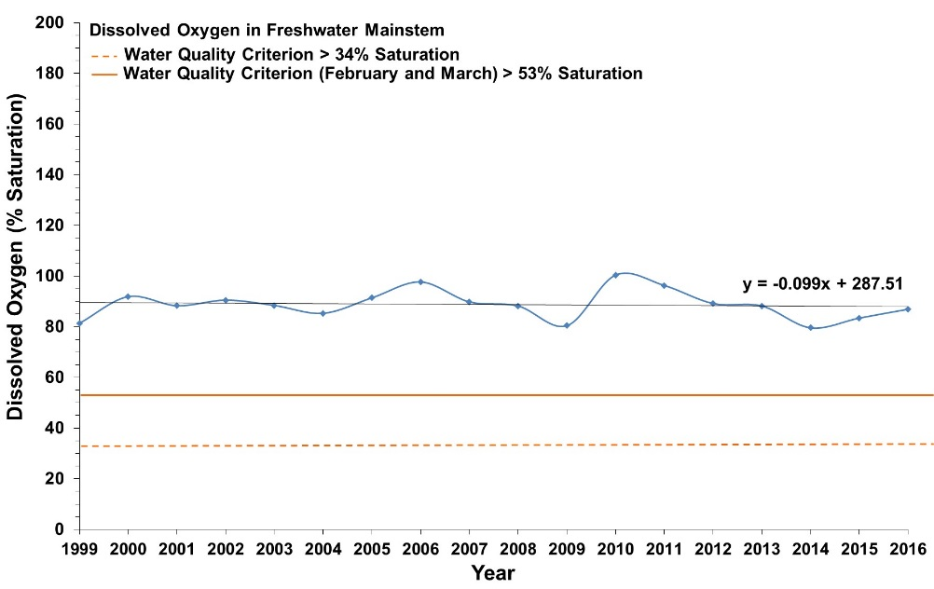
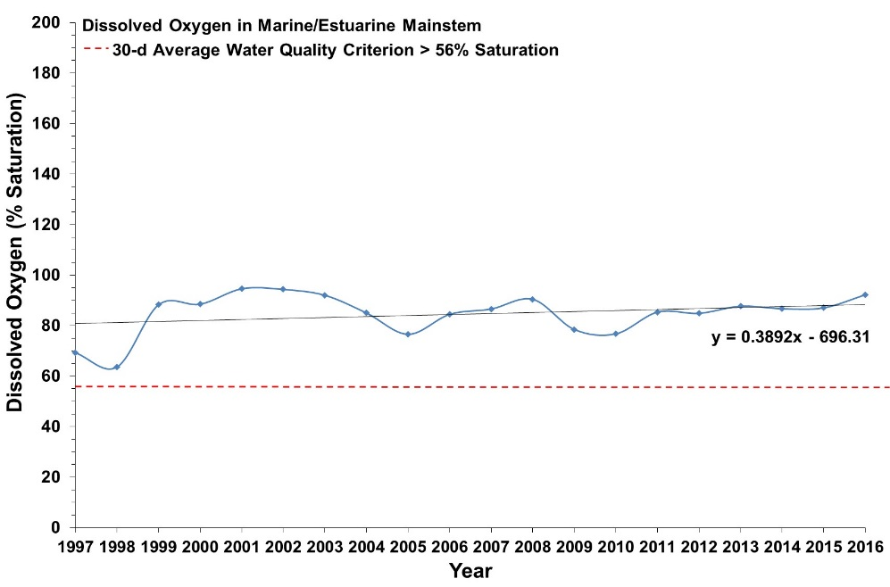
Dissolved Oxygen - Mainstem
Freshwater
Marine/Estuarine
Values above line meet criteria. Mainstem medians exceed criteria in both freshwater and marine reaches.
Notes:
Not updated
Updated RP
The water quality criterion in freshwater (>38% saturation) is equivalent to approximately 3.5 mg/L at 20°C and 2.9 mg/L at 30°C. The water quality criterion in marine/estuarine areas (>53% saturation) is equivalent to approximately 5.09 mg/L at 20°C and 4.28 mg/L at 30°C.

Slide 10
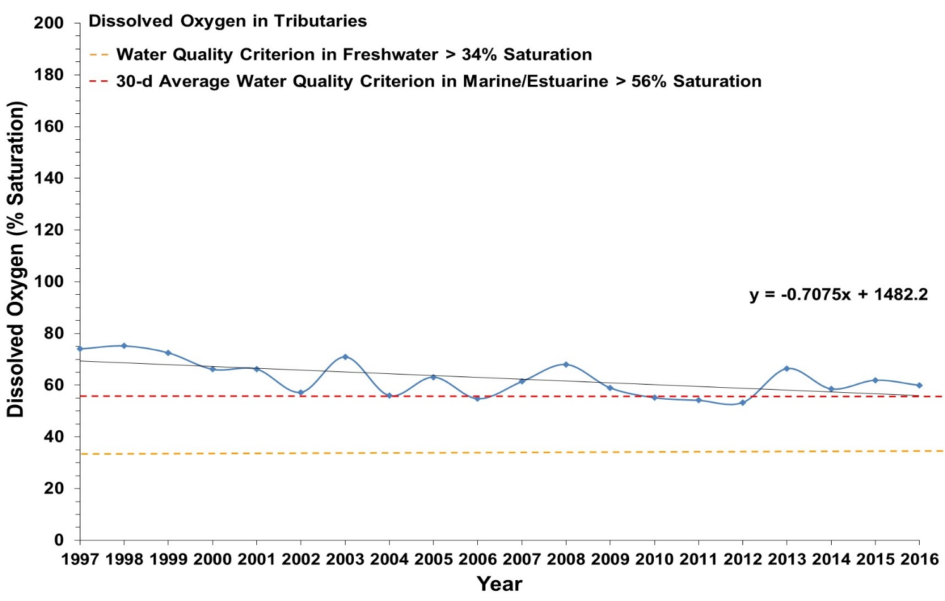
Dissolved Oxygen - Tributaries
DO in tributaries is dependent upon location, time of day, and season.
Notes:
Not updated
Updated RP

Slide 11
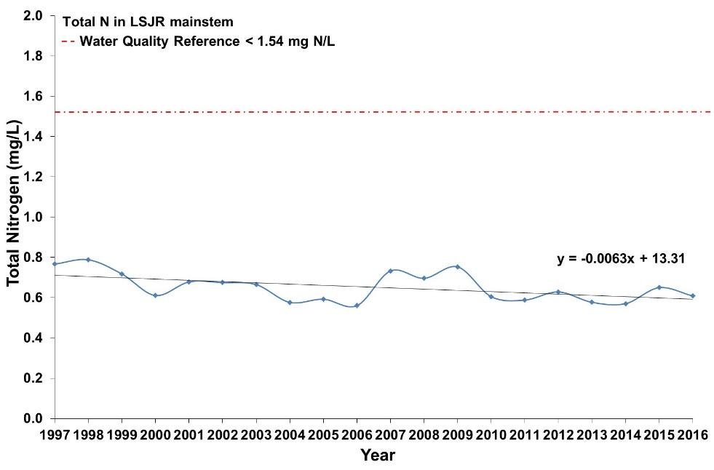
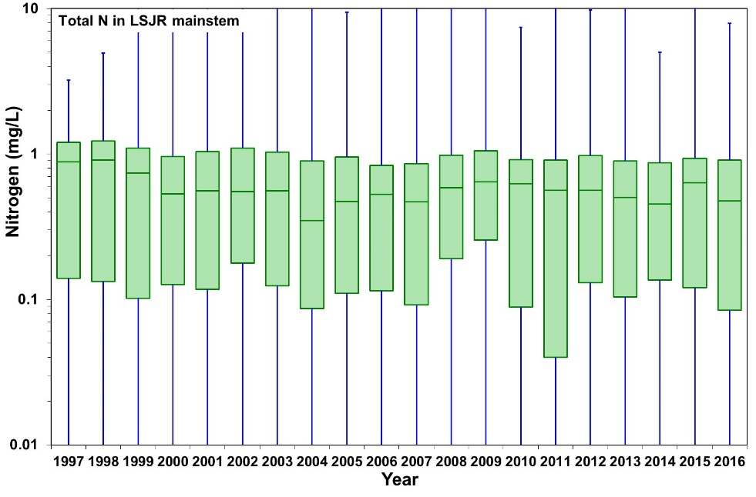
Nutrients
Total Nitrogen Trend - Mainstem
  Total nitrogen levels are decreasing.
  Maximum values regularly exceed peninsular FL numeric standard (not adopted WQC, which is in terms of nutrient loading).
Notes:
Not updated
Updated RP
Figure 2.9 Yearly total nitrogen concentrations from 1997 to 2016 in the A. LSJR mainstem and its tributaries, B. the predominantly freshwater portion of the LSJR mainstem, and C. the predominantly marine/estuarine region of the LSJR mainstem. Data are presented as mean values.

Slide 12
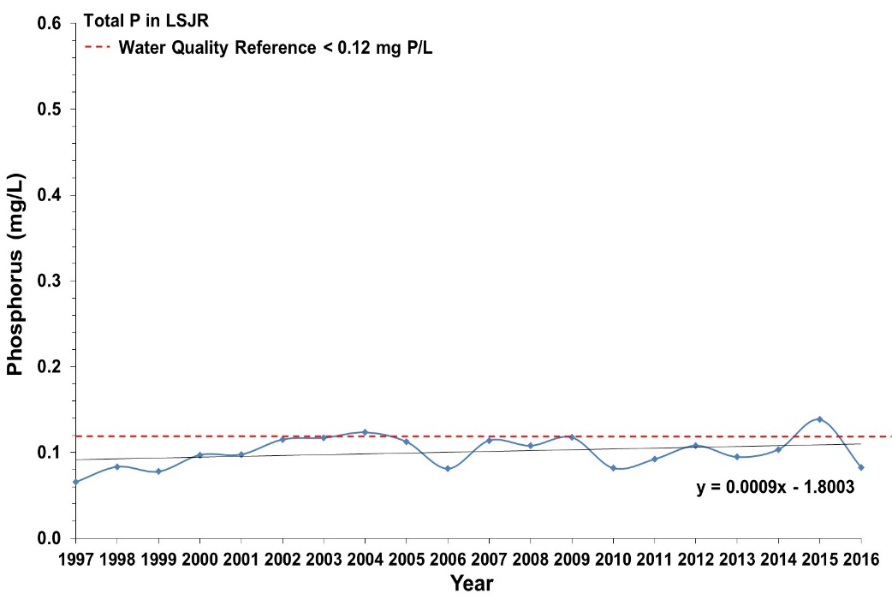
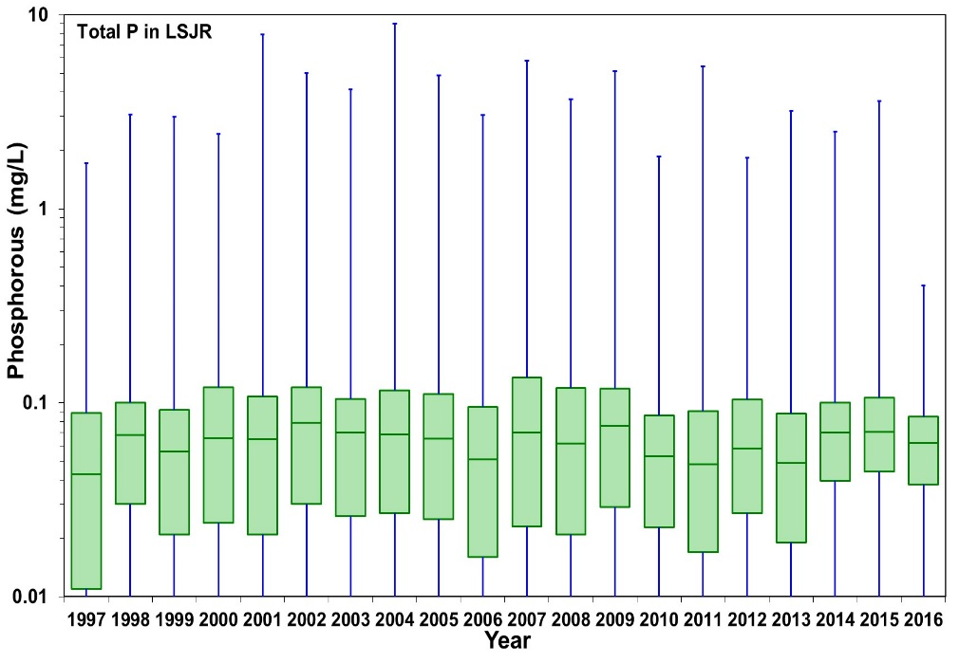
Nutrients
Total Phosphorus Trend - Mainstem
  Total phosphorus levels are decreasing.
  Maximum values also generally fall below peninsular FL numeric standard (not adopted WQC, which is in terms of nutrient loading).
Notes:
Decrease
Updated GFP
Updated RP

Slide 13
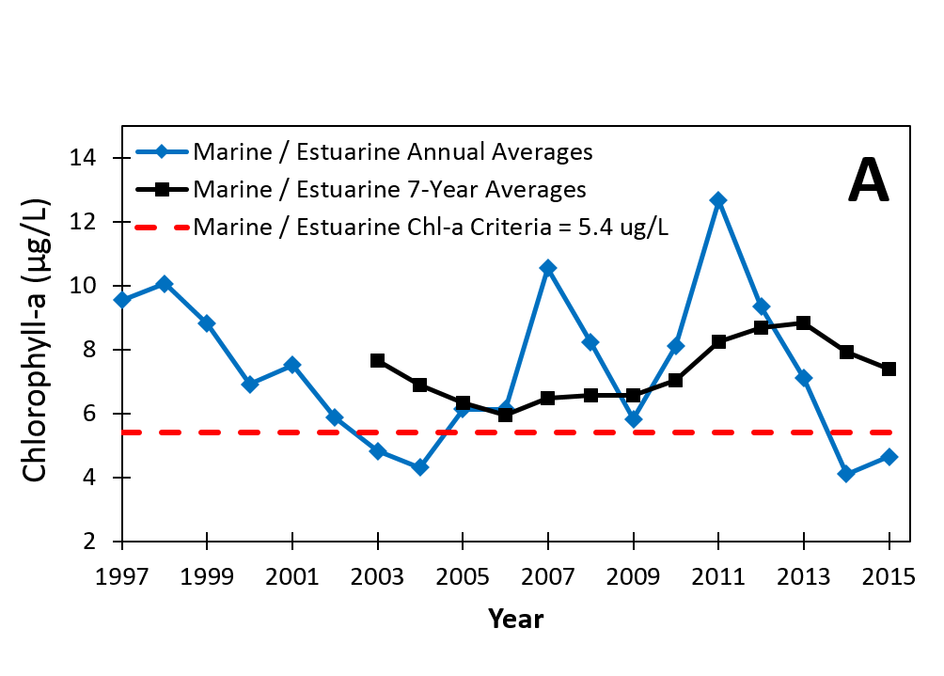
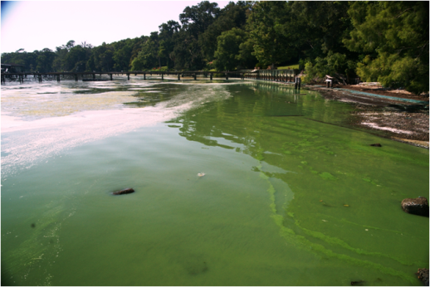
Chlorophyll-a
Phytoplankton indicator used to assess blooms
Pheophytin-corrected to indicate live organisms
One example trend
  Not all blooms are sampled, miss reported toxic events
Notes:
Not updated
Updated RP
Freshwater Chl-a Threshold = 20 ug/l

Slide 14
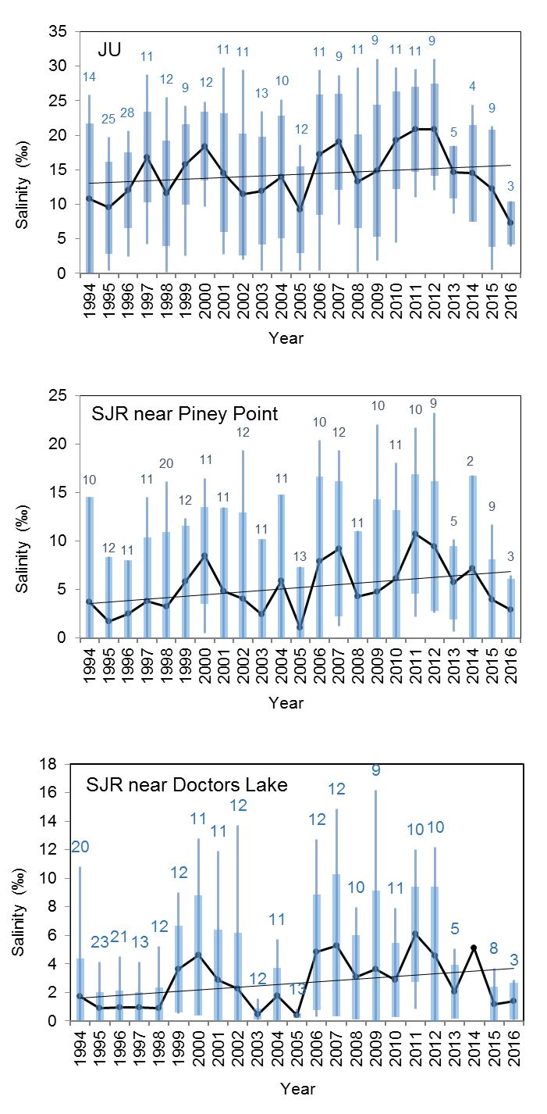
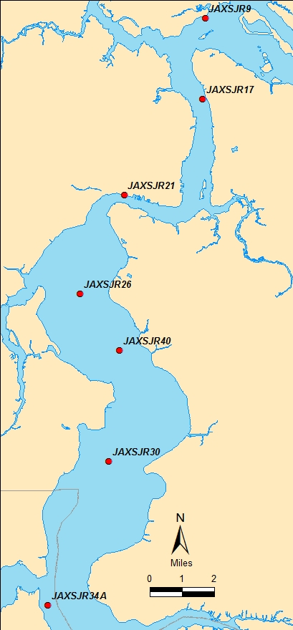
Salinity
Fluctuations with weather
  Drought
  Hurricanes
Daily fluctuations with tide up to Shands Bridge
Increasing mean salinity
Notes:
Updated GFP

Slide 15
Salinity
Potential impacts in the Lower Basin
  Movement south of transition zones
  Redistribution of salt and freshwater fish
  Life-cycle disruption of organisms that need marine and freshwater habitats (e.g., crabs, shrimp)
  Shifts in macroinvertebrate populations
  Less SAV in the north
  Less freshwater hardwood swamps in some areas
Notes:
Kept Updated GFP

Slide 16
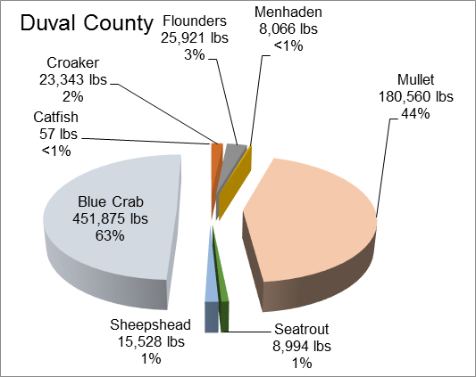
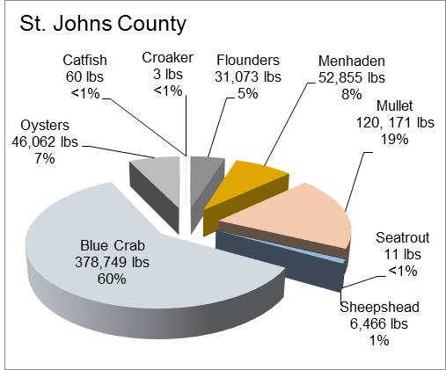
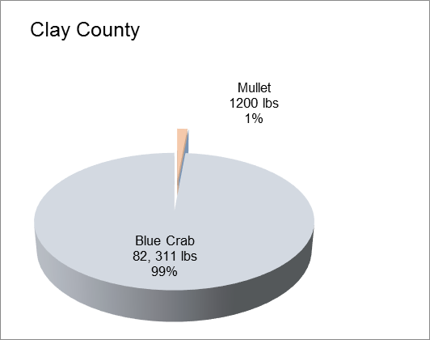
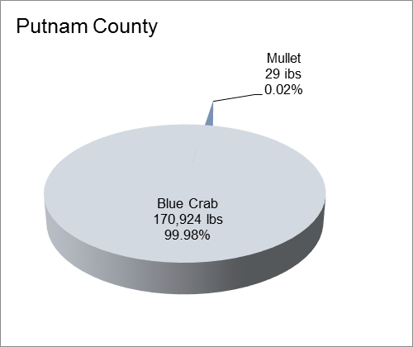
Fisheries
Blue crabs ~65% (1,049,312 lbs) of the total landings in 2016.
Commercial finfish ~33% (536,166 lbs)
striped (black) mullet ( 27%)
flounders and sheepshead (1‐4%)
menhaden, croakers, seatrout, and catfish (<1%).
Notes:
Decrease in blue crabs and increase in Mullet, rest about the same.
Updated GFP

Slide 17
Fisheries
Most finfish and invertebrate species are not in danger of being overfished.
Channel and White Catfish and white shrimp have the potential to be overfished in the near future.
Notes:
Updated GFP
Mullet improving, Sheepshead uncertain, rest the same

Slide 18
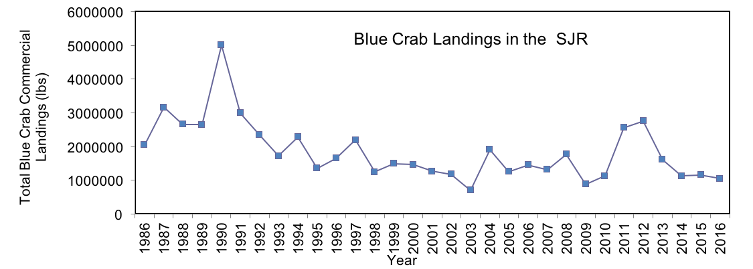
Blue Crabs
Final Age ?
No trend in the southern section where most crabs are caught
Status Uncertain
Trend Uncertain
Male crabs can reproduce many times, females only mate once when mature and can store sperm for several months before actually spawning eggs.
http://www.jacqueauger.com/.../natural/blue_crab.jpg
Notes:
Kept Updated GFP

Slide 19
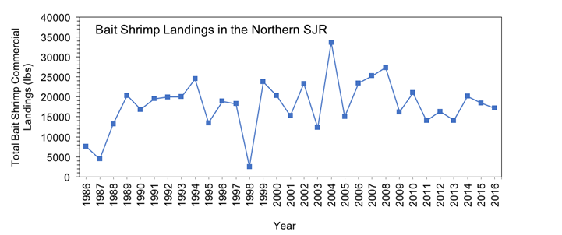
White Shrimp
Commercial data: no trend overall and high annual variability.
Most shrimp caught in the northern part of the river, trend increasing.
Southern section of the river trend decreasing.
Increasing trend in Young of Year shrimp.
Status Uncertain
Trend Uncertain
Brown, pink, white shrimp.
Season closed: April-May: Nassau, Duval, St. Johns, Putnam, Flagler, and Clay Counties.
Notes:
Kept Updated GFP

Slide 20
Aquatic Life
Indicator | Status | Trends
Submerged Aquatic Vegetation | Unsatisfactory | Uncertain
Wetlands | Unsatisfactory | Uncertain
Macroinvertebrates | Uncertain | Uncertain
Threatened and Endangered Species | Satisfactory | Improving
Nonnative Aquatic Species | Unsatisfactory | Worsening
Notes:
Kept

Slide 21
SAV
Tape grass
Vallisneria americana
Water naiad
Najas guadalupensis
Horned
pondweed
Zannichellia palustris
Awl-leaf arrowhead
Sagittaria subulata
Widgeon grass
Ruppia maritima
Significance
  Nurseries
  Food
  Improves water quality
  Reduces erosion
Critical Conditions
  Salinity
  Water clarity
  Shoreline condition
  Epiphytes
Data
  SJRWMD, 2000-2011 plus 2015/16.
  Transects in LSJR: 152 stations (2000-11) 40 stations (2015-2016)
  Aerial observations 2008-2016
Photos by permission: SJRWMD 1998 Volunteer guide to aquatic plants in the LSJR
Notes:
Updated GFP
Common species in LSJRB shown, esp. Vallesneria
Vital for all aspects of aquatic health: food, nurseries, water quality, shoreline
Complex interactions of salinity and water clarity along w/ shoreline and presence of plants that cover leaves reducing photosynthesis
Gerry wrote section with data from SJRWMD 2000-2011 headed up by (Dean Dobberfuhl, Chuck Jacoby, Lori McCloud and others) and aerial observations (JU-MSRI) from 2008-2013.
Remember grass grow best from 0-12ppt; can tolerate 15-20ppt for short periods; SAV needs more light in higher salinity environments
Will describe some of the former data in the following

Slide 22
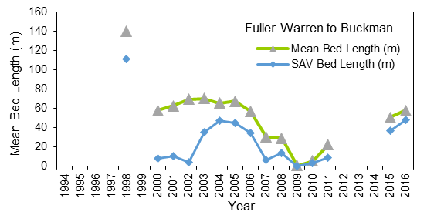
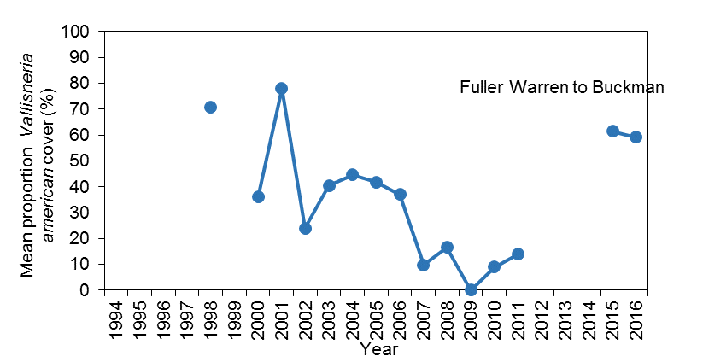
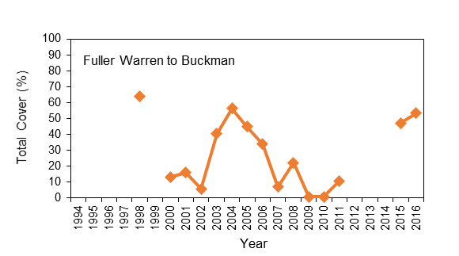
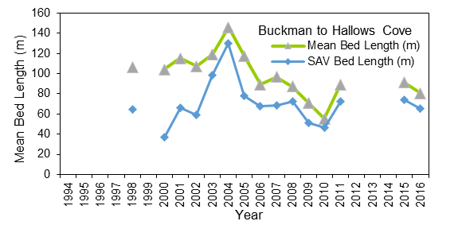
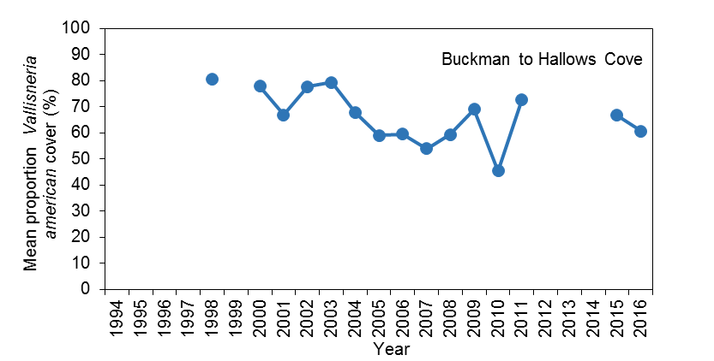
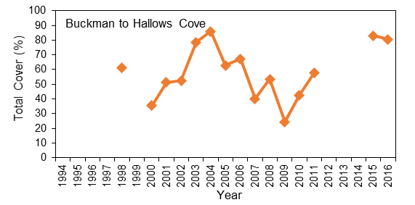
SAV
Fuller Warren Bridge
Tape Grass
Widgeon grass
Horned pondweed
Water naiad
Bolles
Buckman Bridge
Doctors Lake
Moccasin Slough
Tape grass
Widgeon grass
Water naiad
Hallows Cove
Notes:
Updated GFP
Today will examine mean bed length and total coverage (study covered several other parameters) for different sections of the river beginning with the north most from FWB to Fuller Warren
Note how many sites – numerous compared to now I used the yellow ones GT=Ground Truth sites
Perhaps think about %Total Cover of vallesneria as the amount of bare patches or “patchiness within the grass beds” (less % cover more patchiness or bare spots)
Also worth remembering that the high in 2004 is probably due to fresher conditions that year when 4 hurricanes impacted Florida-Charley/Francis/Ivan/Jeanne.
I look at the measurements taken in 1998 as the base line for which we see greatest declines north of Buckman.
Shown are SAV species that compose >10% of total in the different regions
SAV more abundant upstream
Mean bed length in north section declined from a high in 2004 to a low of < 10 m in 2009, similar with total coverage
Similar pattern south of the Buckman lowest bed lengths in 2009 but more abundant; compare 140 m bed length, > 80% total coverage in south to ~ 80 m bed length and 60% coverage in the north.
uncertain about status since that time.

Slide 23
SAV
Summary
  Highly variable over time due to weather and other factors
  Decline in grass bed coverage northern section
  End of monitoring in 2011 limits understanding of SAV dynamics at a critical time
  Limited monitoring in 2015/16
INDICATOR | STATUS | TREND
Submerged Aquatic Vegetation | Unsatisfactory Impacts increasing | Conditions worsening
Notes:
Updated GFP
Submerged aquatic vegetation (SAV), has experienced fairly stable levels south of Buckman Bridge, with variations caused by drought and increased salinity.
Declines in SAV north of Buckman since 1998.
Any declines/fluctuations in the south tend to be more due to color in the water limiting growth - from periodic storm events rather than salinity spikes.
SAV is essential to the survival of many other aquatic species as both food and spawning area.
About 12 species, but Val.. is the dominant species.

Slide 24
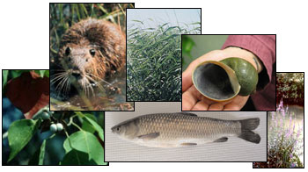
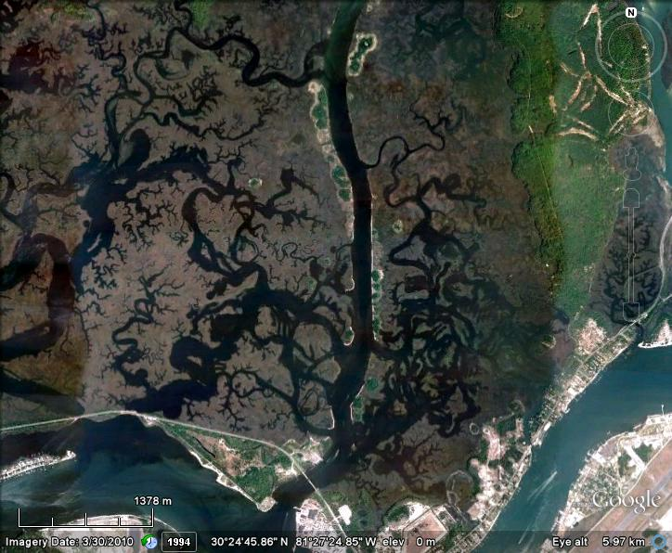
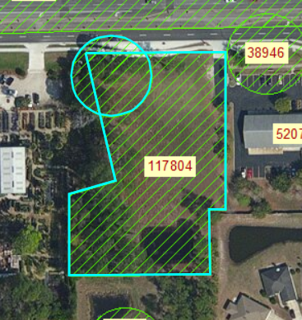
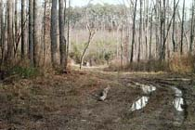
Wetlands
  83% freshwater, ~44% freshwater forested.
Significance
  Nurseries
  Habitat
  Food
  Improve water quality
  Stabilize banks
  Provide flood control
Stressors
  Pollutants
  Sea Level Rise
  Hydrology changes
  Invasive Species
  Fragmentation
http://www.nwrc.usgs.gov/topics/invasive_species/index.
htmwww.water.ncsu.edu
Sjrwmd permitting site
Notes:
Kept

Slide 25
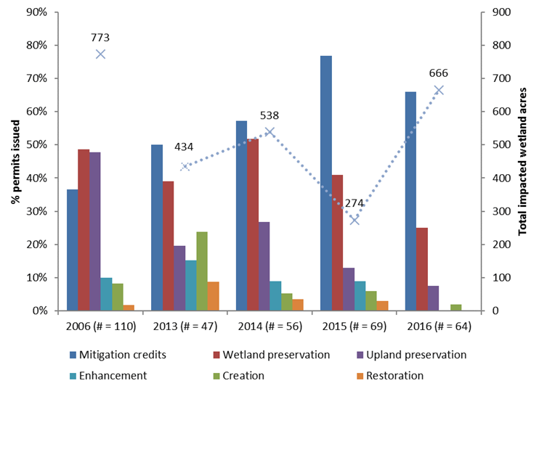
Wetlands
Notes:
Over the past ten years, the status of wetlands was UNSATISFACTORY. From 2008-2016, trends were UNCERTAIN and then changed to WORSENING in 2017.
Lately resource permit records have become more publicly accessible and therefore tracking of impacted wetland acreage and mitigation efforts is possible.
With the end of the recession, a development boom has contributed to the number of wetlands lost to dredge and fill activities.
Rather than on-site mitigation with wetland creation or restoration, more permittees purchase mitigation credits from mitigation banks and/or preserve remaining wetlands.
Because mitigation banks are typically miles from the impacted wetland, there is concern that the benefits that wetlands provide to ecosystems are shifting away from urban centers.
Preservation of existing wetlands, although laudable, does not address the loss of wetlands due to dredge and fill activities.
Added GFP updated
Mitigation credits do not
Mitigation banks and credits
Not a “replacement”
Loss of ecosystem functions are not replaced with already existing wetlands
Ecosystem functions not fulfilled
Increasing % are > 30miles away!
In general, restored and created wetlands do not reach full diversity or functioning, even after 100 years.
During the 2000s, relatively few wetlands were created or restored with most mitigation occurring through the preservation of uplands/wetlands.
The % of mitigation credits per acre lowest in 2006 versus subsequent years, virtually double in 2015, still high in 2016.

Slide 26
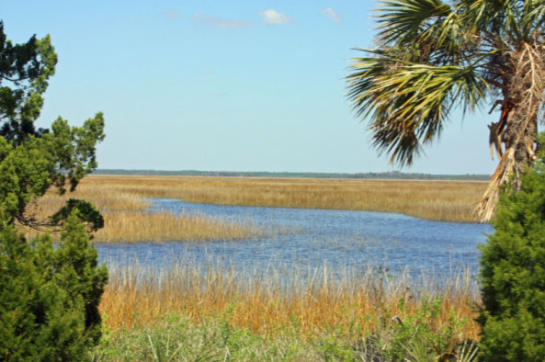
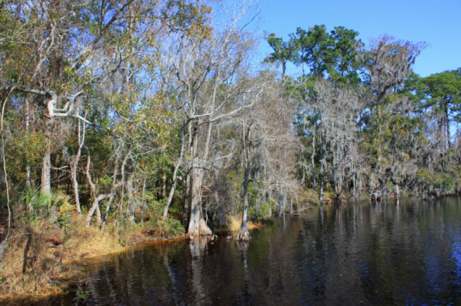
Wetlands
Summary
  Easier to track LSJRB wetlands status
  Concerns:
    Shifts in wetlands types from mitigation and salinity changes
    Loss of coastal wetlands
    Loss of function by connectivity disruptions
Photos by Heather McCarthy
INDICATOR | STATUS | TREND
Wetlands | Unsatisfactory | Uncertain
Notes:
Kept

Slide 27
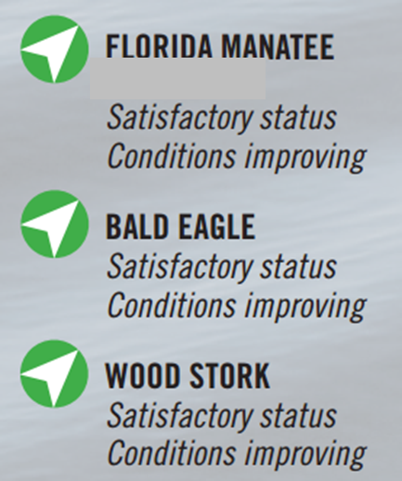

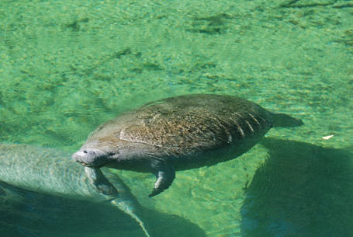
Endangered & Threatened
Numbers of manatees, bald eagles and wood stork greatest since 2000
(JU 2016, Audubon 2016)
Photo: Dave Menken, USFWS.
Photo by Wayne Lasch (PBS&J)
Chelsea Bohaty, JU MSRI
Notes:
Updated GFP

Slide 28
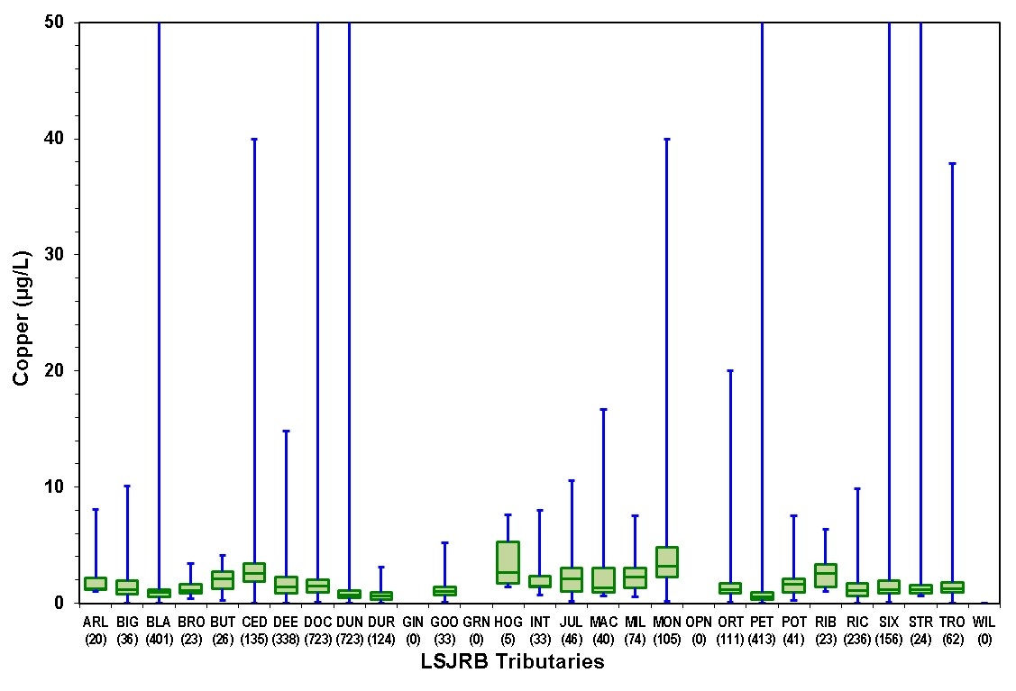
Contaminants
Metals in water: Arsenic, cadmium, copper, lead, nickel, silver, zinc
  Mainstem - Maxima, medians down since 2009 for many
  Tributaries
  Copper biggest problem
  Many tributaries do not have enough data for trend analysis
Notes:
Old not updated
Updated RP
Deleted slide with ratings – too much there that we don’t talk about.
Sediment PAHs: Unsatisfactory, Improving in the Northern section and Worsening in the Southern section
Sediment PCBs, pesticides, metals: Unsatisfactory and Unchanged since 2008
Water column metals: Mixed/Unchanged, Improving in the mainstem and Uncertain in the tributaries
All data has become more limited

Slide 29
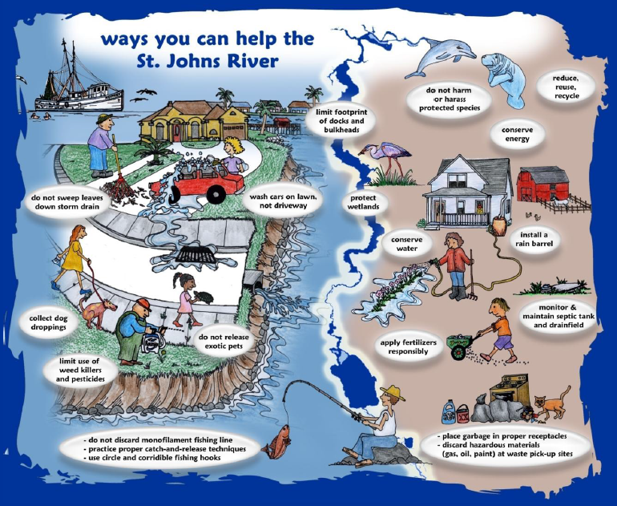
By Heather McCarthy
Thank you! Questions?
Notes:
Kept
Jacksonville University St. Johns River Poll:
2012-2016 Results Comparison
The polling was done under the direction of Dr. Ray Oldakowski, Professor in the JU Department of Geography & the Environment.
Fast Facts:
Rates of using the river for recreation/enjoyment by Jacksonville area residents remained similar from 2012-2016.
Only about 25% of area residents fish on or along the St. Johns River, 30% boat, 10% swim and 50% walk along the river at least once a year.
The number of residents that consider the river degraded and in need of a major cleanup increased from 52% to 59%.
The number of residents who think there is a direct connection between their actions and the health of the river increased from 55% to 69%,
but fewer residents say they are knowledgeable about what they can do to help protect the river, a drop from 48% to 37%.
The number of residents who say they are “trying very hard” in their personal efforts to protect the St. Johns River dropped from 16% to 7%.
Of those familiar with the proposed project to dredge a portion of the St. Johns River, 51% say they are opposed to it.

Slide 31
Manatee Deaths Duval 2017
Manatee deaths from all causes 2017, Duval Co., FL.
 |  | Manatee |  | Total | Mortality | Location Info.
Count | Date | field ID | Sex | Length | category
1 | 1/11/2017 | MNE17001 | F | 173 | 5-Natural-Cold Stress | West bank of sjr (s of Sadler Pt. n of NAS)
2 | 2/8/2017 | MNE17007 | M | 212 | 1-Watercraft | Talleyrand
3 | 5/1/2017 | SWFTm1705b | M | 285 | 8-Undetermined, Other | Ortega Basin
4 | 5/4/2017 | SWFTm1710b | F | 264 | 6-Natural, Other | ICW Pablo Creek
5 | 5/7/2017 | MNE17012 | M | 290 | 8-Undetermined | Mill Cove Harbor North
6 | 5/13/2017 | MNE17013 | M | 139 | Perinatal ( =< 150 ) | Julington Creek
7 | 6/5/2017 | MNE17015 | M | 308 | 1-Watercraft | ICW s of Atlantic Blvd. west bank
8 | 6/10/2017 | MNE17017 | F | 124 | Perinatal ( =< 150 ) | Fishing Creek
9 | 6/25/2017 | MNE17021 | M | 220 | 8-Undetermined | Sherman Creek
10 | 6/28/2017 | MNE17022 | M | 288 | 1-Watercraft | Blount Island sjr
11 | 7/3/2017 | MNE17025 | M | 291 | 1-Watercraft | Garden Creek
12 | 7/15/2017 | MNE17027 | F | 138 | Perinatal ( =< 150 ) | Cedar Creek
13 | 7/20/2017 | MNE17028 | F | 225 | 8-Undetermined | Downtown sjr
14 | 8/14/2017 | MNE17033 | F | 110 | Perinatal ( =< 150 ) | Silversmith Ck., off Pottsburg Creek
15 | 8/15/2017 | MNE17034 | M | 274 | 1-Watercraft | Opposite Talleyrand, JU side, south of JU
16 | 9/7/2017 | MNE17036 | F | 123 | Perinatal ( =< 150 ) | Pottsburg Creek, towards Beach Blvd.
17 | 10/3/2017 | MNE17038 | M | 242 | 8-Undetermined | Ortega River
Source: FWC, FWRI 2017.

Slide 32
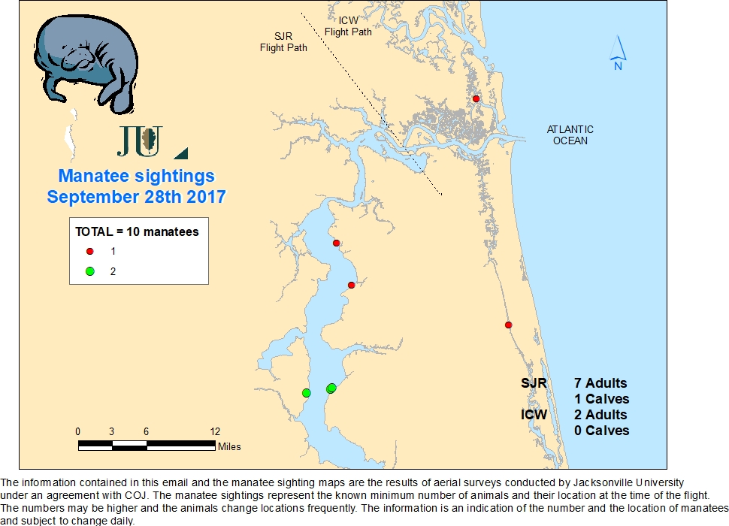
Manatee Sightings

Slide 33
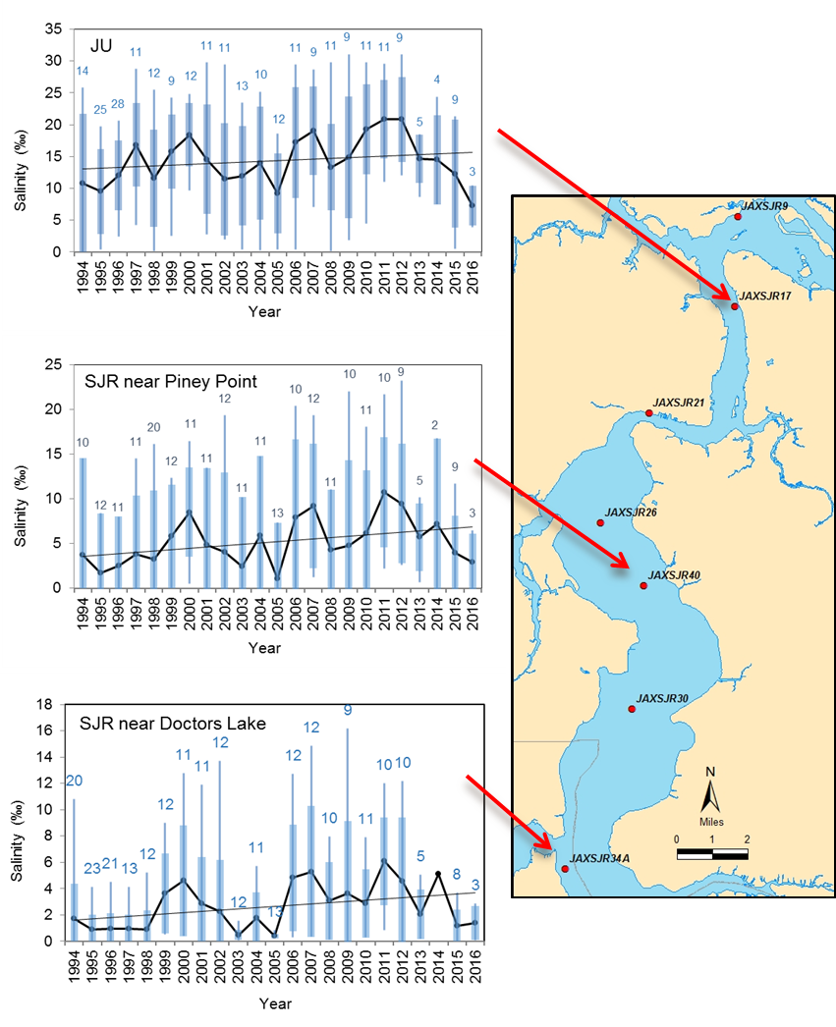
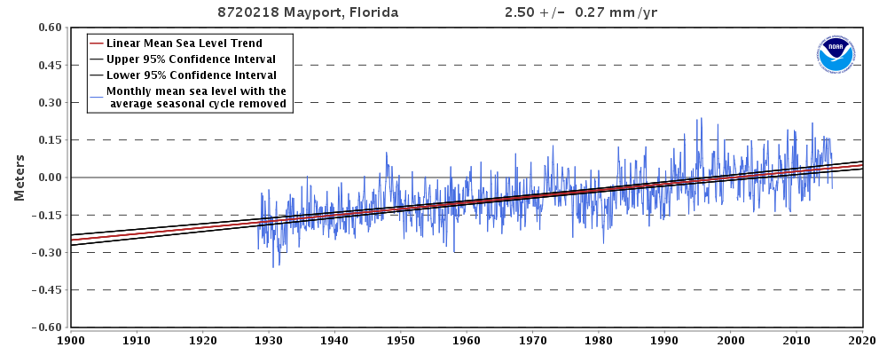
Salinity
~ +1 inch/decade
~ +8 inch since 1928
http://tidesandcurrents.noaa.gov/sltrends/sltrends_station.shtml?stnid=8720218
Notes:
Kept and Updated GFP

Slide 34
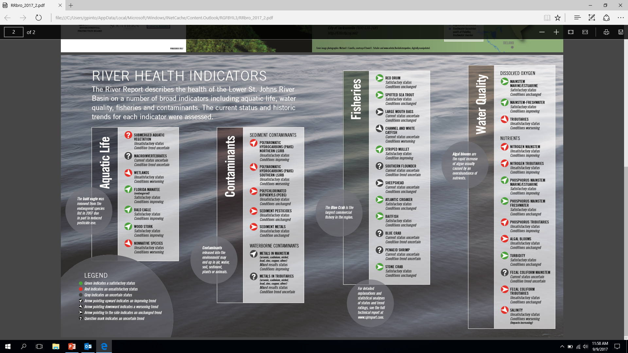

Slide 35
Overview 2017
The trends of some indicators have improved:
Total nitrogen levels in the mainstem and tributaries have declined.
Total phosphorus levels in the mainstem and tributaries have declined.
Dissolved oxygen levels in the mainstem are improving.
Conditions for 3 wildlife species have improved:
(bald eagle, the wood stork, and Florida manatee).
Notes:
Added

Slide 36
Overview 2017
The trends of some indicators have worsened:
Salinity has gradually risen over the last two decades and is expected to continue its increase, with increasing potential negative impacts on submerged aquatic vegetation and the aquatic life that depends upon it.
Nonnative species increased from 56 total species in 2008 to 80 in 2017, and the spread of lionfish and Cuban treefrogs is of particular concern due to their impacts on the native ecosystem.
Wetlands continue to be lost to development pressures.
Notes:
Added

Slide 37
Overview 2017
The trends of many indicators are unchanged:
Dissolved oxygen levels in the tributaries have remained unsatisfactory and have not shown improvement.
Chlorophyll a, an indicator of harmful algal blooms, has not decreased in the ten-year timeframe and shows no indication of decreasing soon.
Fecal coliform levels remain significantly above water quality criteria in many tributaries.
Submerged aquatic vegetation has experienced some very recent regrowth due to rainfall, but the long-term trend is uncertain.
Most finfish and invertebrate species are not in danger of overfishing, with the exception of channel and white catfish, which both have the potential to be overfished in the near future.
Notes:
Added

